Slide 1


Object Detection using TensorFlow Lite Raspberry Pi 4 4GB + PiCamera
Simon Chu

Slide 2
Introduction
The purpose of the project is to develop Object Detection with TensorFlow Lite (Unsupervised Learning). The intent is to have real-time detection of objects with available hardware (e.g. camera or webcam).
A Raspberry Pi 4 and a PiCamera was utilized for the hardware aspect for object detection.
For software, TensorFlow Lite, OpenCV, and Python 3 was utilized to develop the real-time identification of objects.
The most impressive aspect of this event is the ease of creating a real-time detection application APIs from TensorFlow and the ability to utilize it with a Raspberry Pi 3B+ or 4.
https://github.com/schu-lab/TensorFlow-Object-Detection

Slide 3
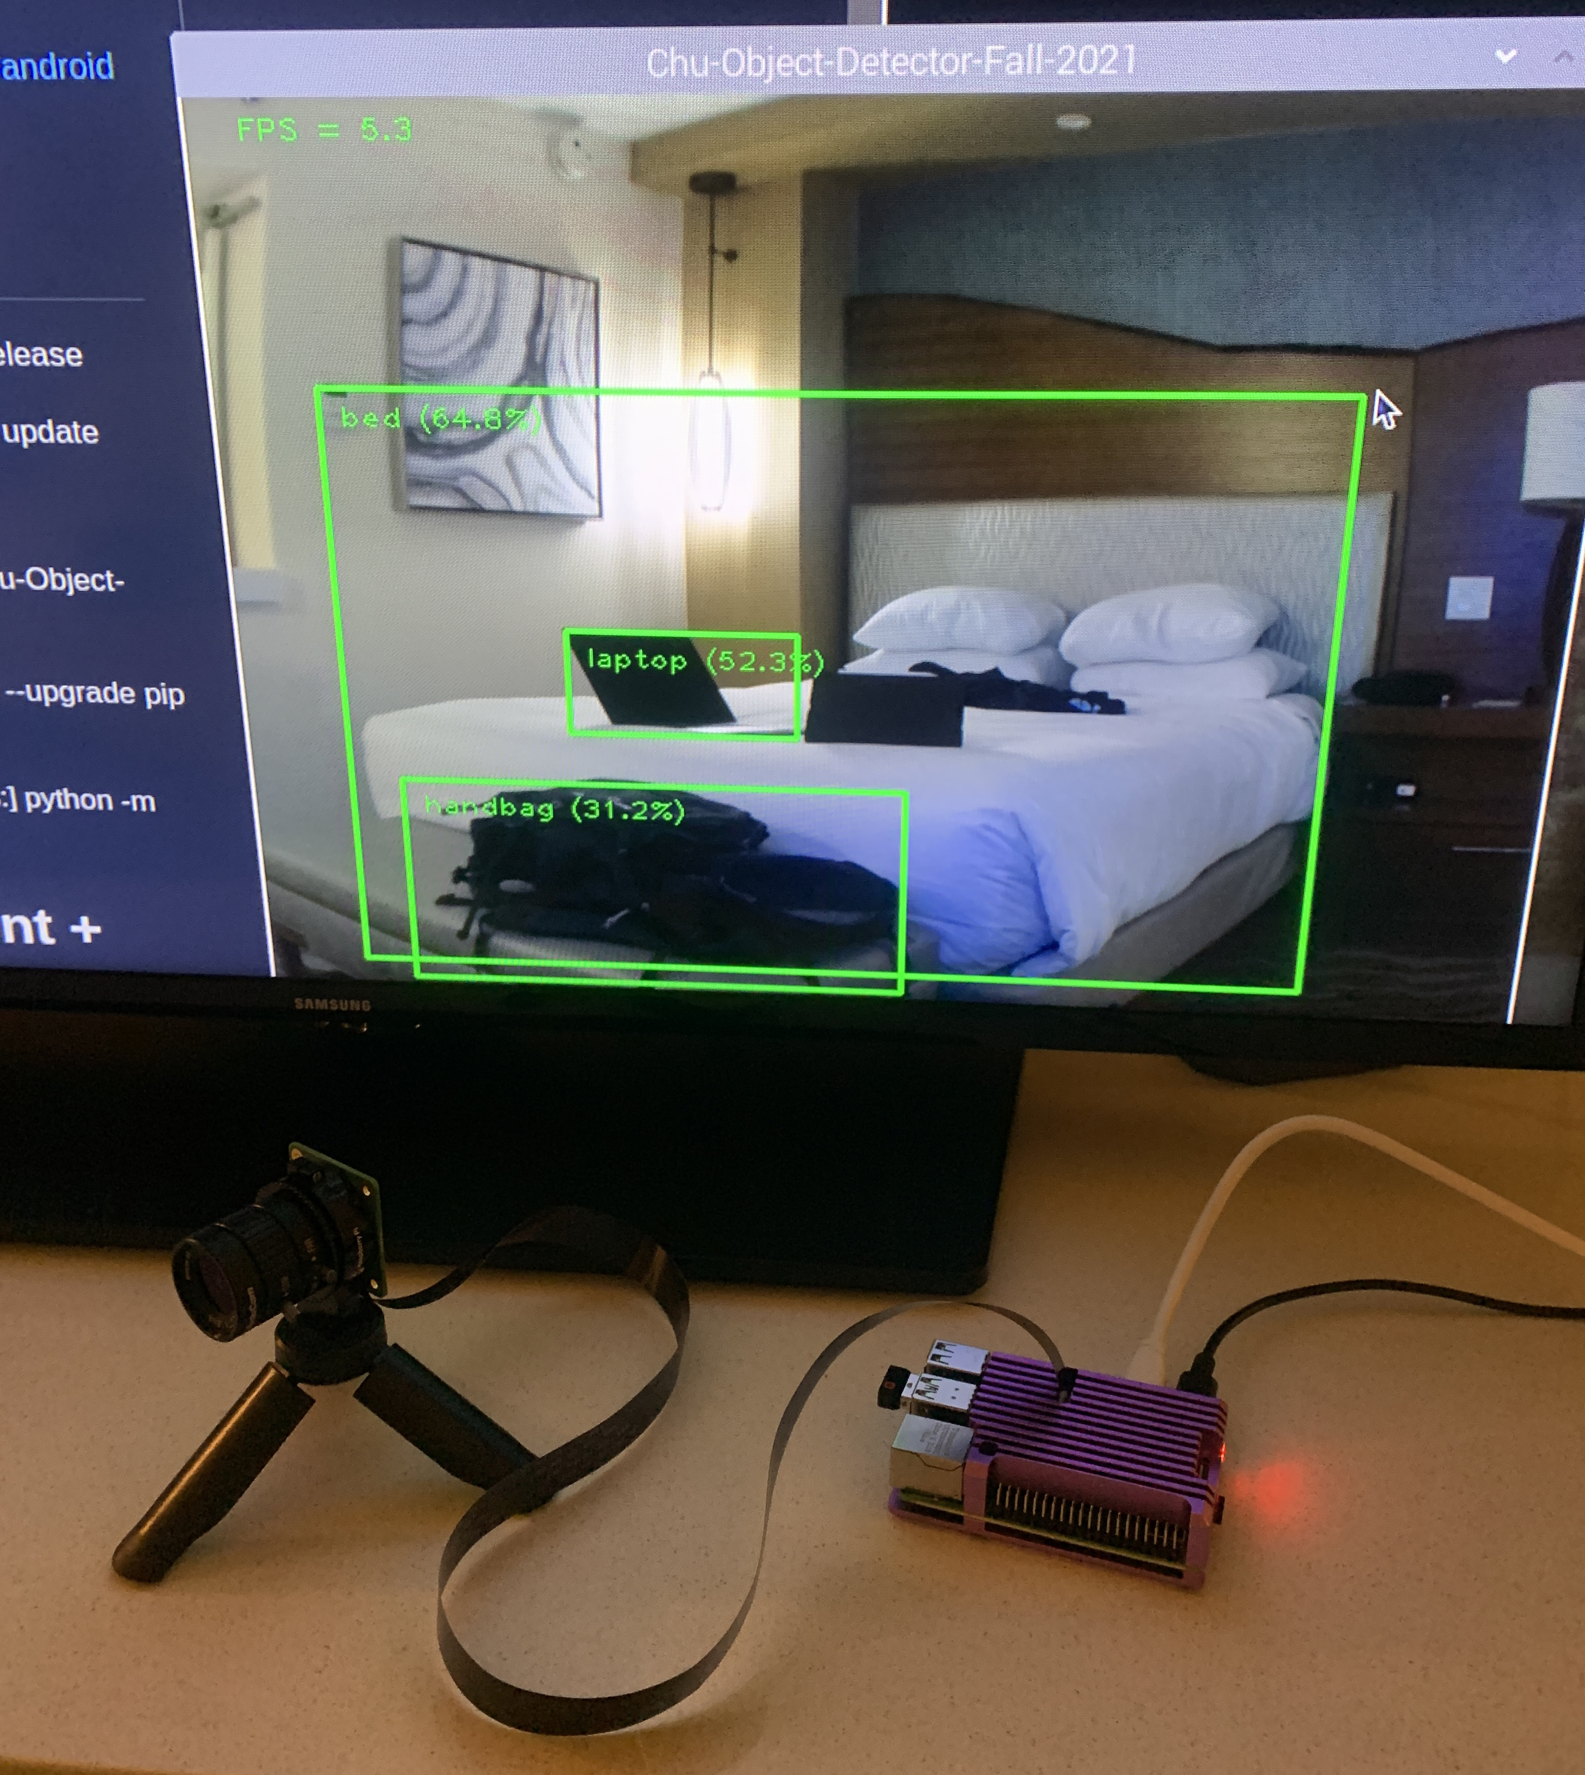

Hardware Required
Raspberry Pi 4 – 4GB
PiCamera 2018 v1.0
6mm CS Lens
Portable Tripod

Slide 4



Software Required
Python 3
TensorFlow Lite
OpenCV

Slide 5
Datasets:
TensorFlow Lite Pre-trained Model
Handgun Images: https://sci2s.ugr.es/sites/default/files/files/TematicWebSites/WeaponsDetection/BasesDeDatos/WeaponS.zip
Handgun Annotation: https://sci2s.ugr.es/sites/default/files/files/TematicWebSites/WeaponsDetection/BasesDeDatos/WeaponS_bbox.zip
Android Toys Data Set - .jpg + .xml (Pascal VOC): https://storage.googleapis.com/download.tensorflow.org/data/android_figurine.zip

Slide 6
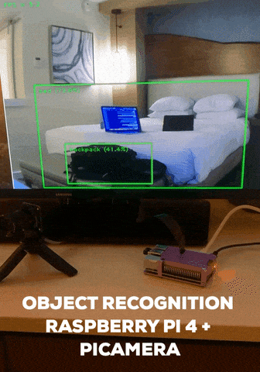
Demo
Location: Room
Note the Boundary Box with Object Label and Confidence/Accuracy

Slide 7
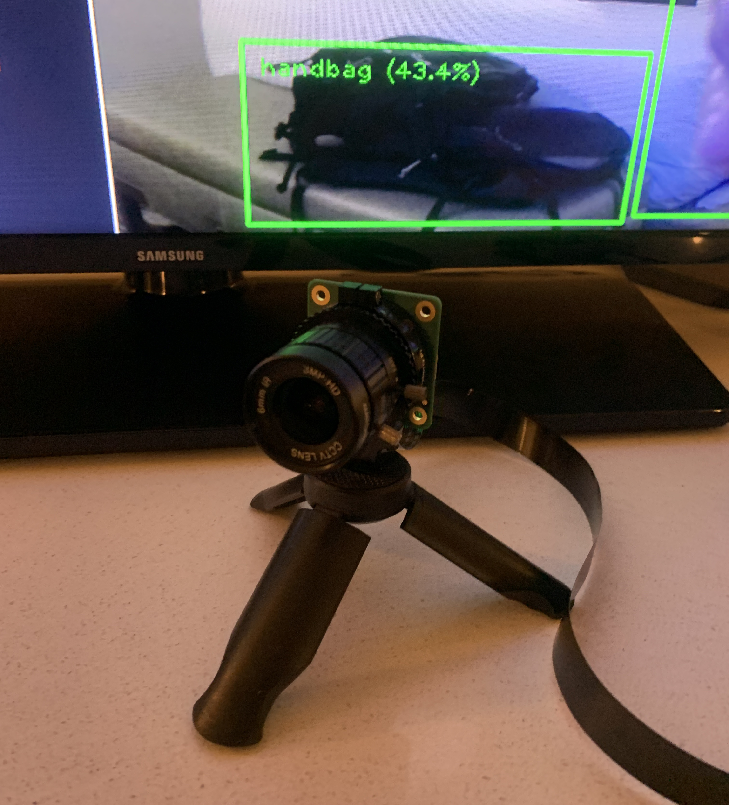
How it works:
OpenCV used to capture images from the PiCamera
Initialize TensorFlow Lite Object Detection Model – Unsupervised Learning using TensorFlow Lite
Captures the frames continues from the camera and repeats the frame to the object detector.
Creates visualization boundary boxes and confidence scores

Slide 8
Training an object detection model
Create a training data set
Collect images and labeling (Most effort / time-consuming step)
Train a custom model
Use Tensorflow Lite Model Maker - https://colab.research.google.com/github/khanhlvg/tflite_raspberry_pi/blob/main/object_detection/Train_custom_model_tutorial.ipynb
Deploy the model
Use on Raspberry Pi by replacing a custom model

Slide 9
Step 1: Create a training dataset
Use LabelImg (Open Source App) to draw a boundary box and label
https://github.com/tzutalin/labelImg
The more images you collect, the better the accuracy.
Training Images - 80% of your dataset – Used to train model
Test Images – 20% of your dataset – Used later to evaluate model

Slide 10
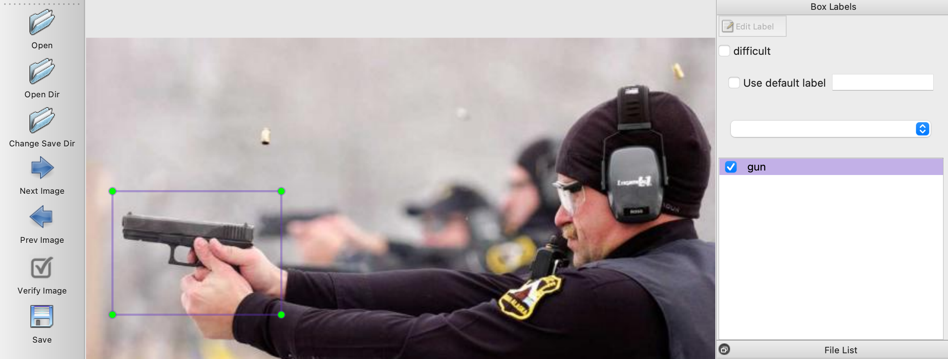
Step 1a: Using labelImg
Example of boundary box on subject using labelImg
Creates an .xml file using Pascal VOC format

Slide 11
Step 2: Use Model Maker Object Detection
Use TensorFlow Lite Model Maker Object Detection utilizing dataset
https://colab.research.google.com/github/khanhlvg/tflite_raspberry_pi/blob/main/object_detection/Train_custom_model_tutorial.ipynb
Load the Dataset
Choose Model Architecture
EfficientDet-Lite0 to EfficientDet-Lite4
Train the TensorFlow model with the training data
Evaluate the model with validation data
Look at Average Precision (AP)
Export as a TensorFlow Lite Model
Evaluate the TensorFlow Lite Model

Slide 12

Step 2: Utilizing EfficientDet-Lite0
Baseline Evaluation

Slide 13
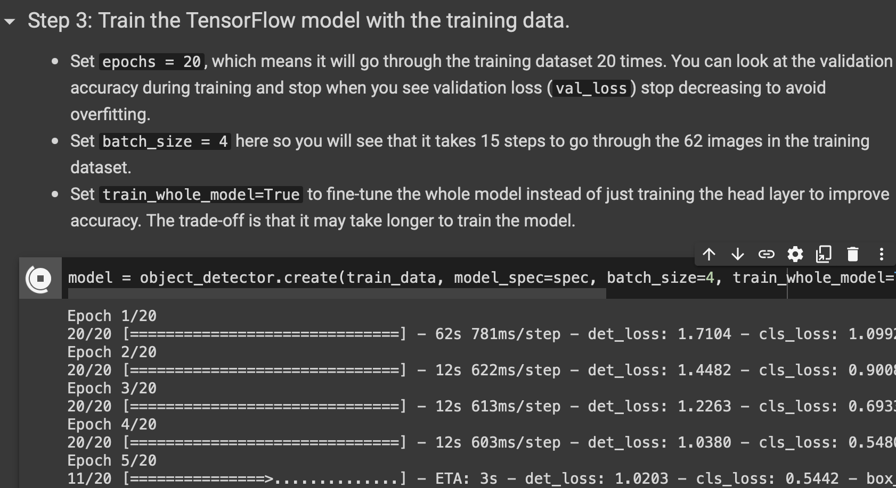
Step 2c: Training the model using Training Data (80%)
Used TensorFlow Model Maker Object Detection Tool
Epochs: # of times training data.
Batch size: divide by training dataset size

Slide 14
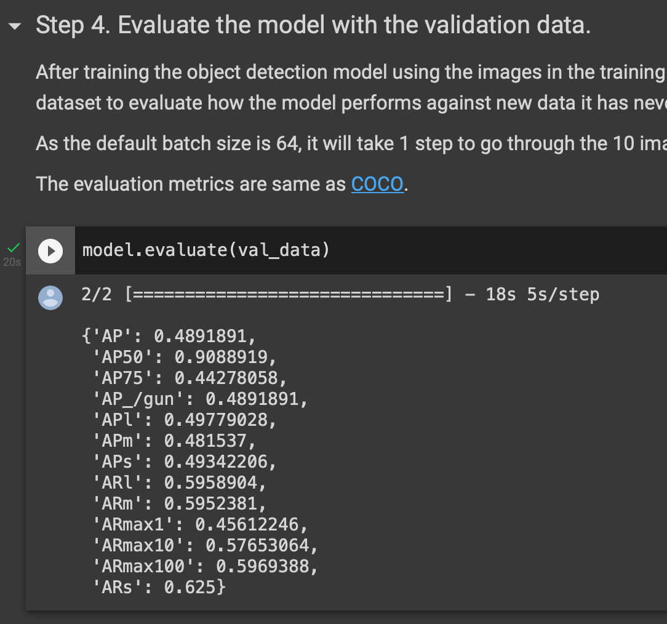
Step 2d: Evaluate Model using Validation Data (20%)
How it performs with the validation dataset:
Average Precision: 48.9%

Slide 15
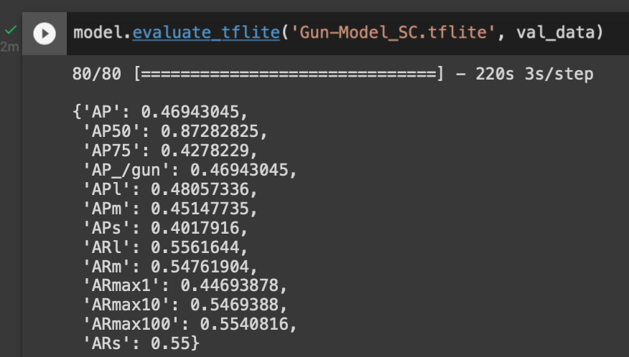
Step 2f: Evaluate TensorFlow Lite Model
TensorFlow Model Average Precision: 46.94%
NOTE: Difference between Training & Validation Data (48.92%) and TensorFlow Lite Model (46.95%)

Slide 16
Step 2: Utilizing EfficientDet-Lite1
Accuracy vs. Response Time
Comparing Different Models

Slide 17
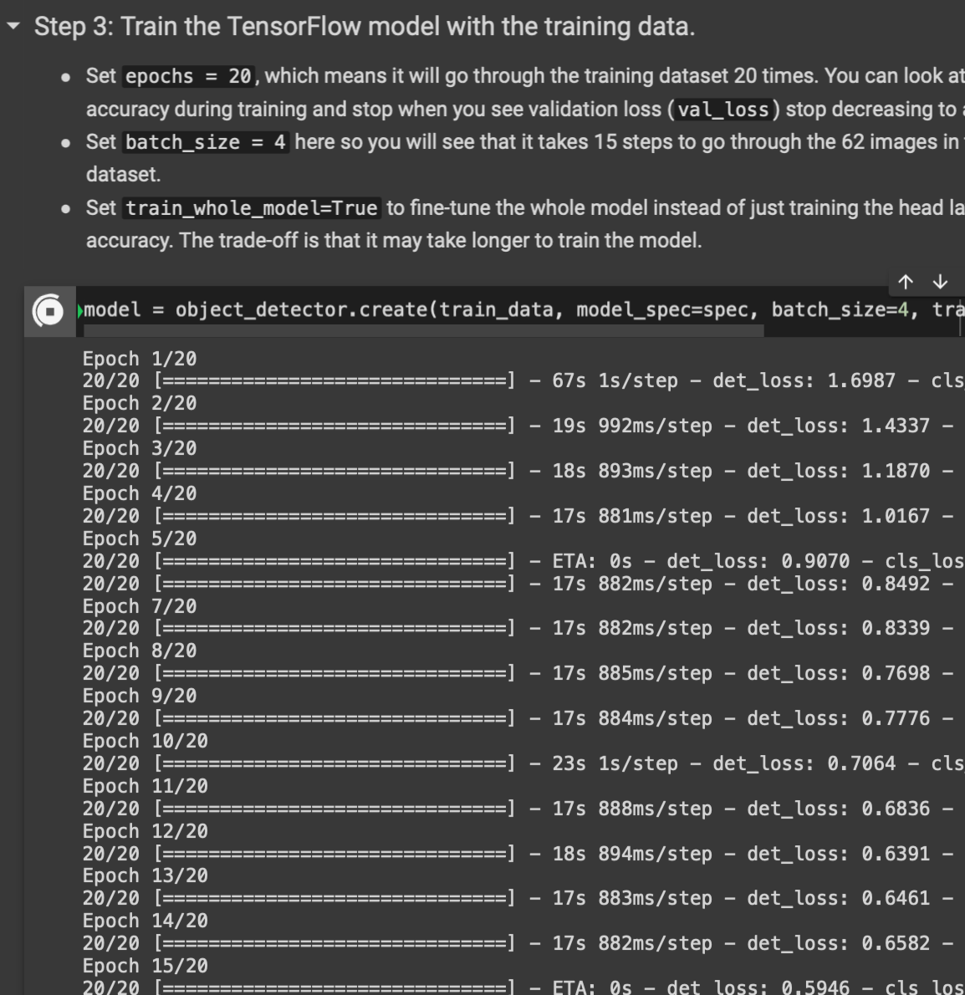
Step 2c: Training the model using Training Data (80%)
Used TensorFlow Model Maker Object Detection Tool
Epochs: # of times training data.
Batch size: divide by training dataset size
Note increased time per iteration dependent of model
Det1: ~18 seconds (avg)
Det0: ~12 seconds (avg)

Slide 18
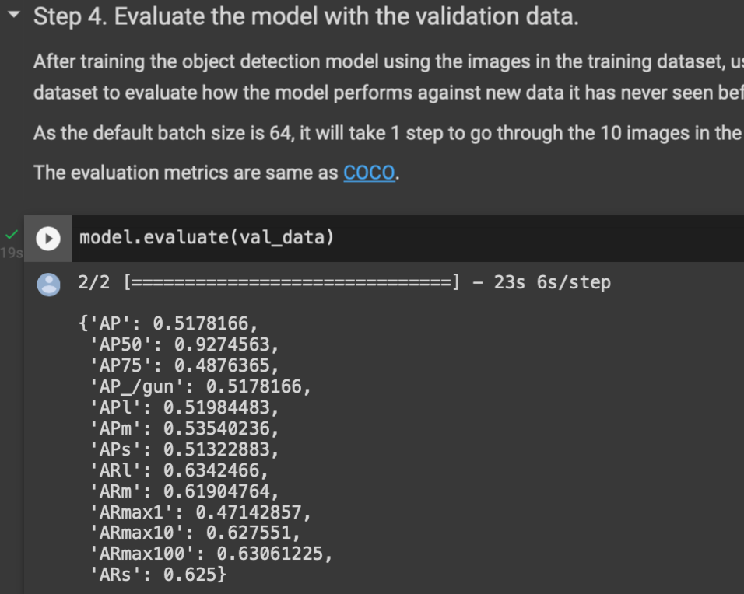
Step 2d: Evaluate Model using Validation Data (20%)
How it performs with the validation dataset:
Average Precision: 51.7%
Increased AP (49% → 52%) however slower response time (12s → 18s)

Slide 19
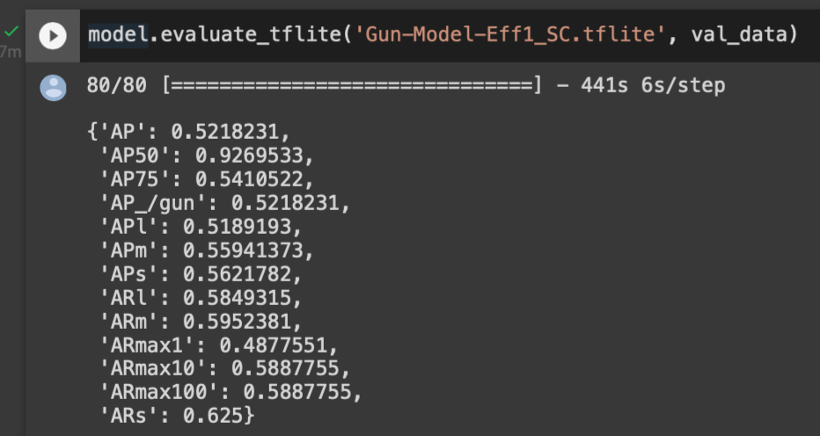
Step 2f: Evaluate TensorFlow Lite Model
TensorFlow Model Average Precision: 52.18%
NOTE: Difference between Training & Validation Data (51.78%) and TensorFlow Lite Model (52.18%)

Slide 20
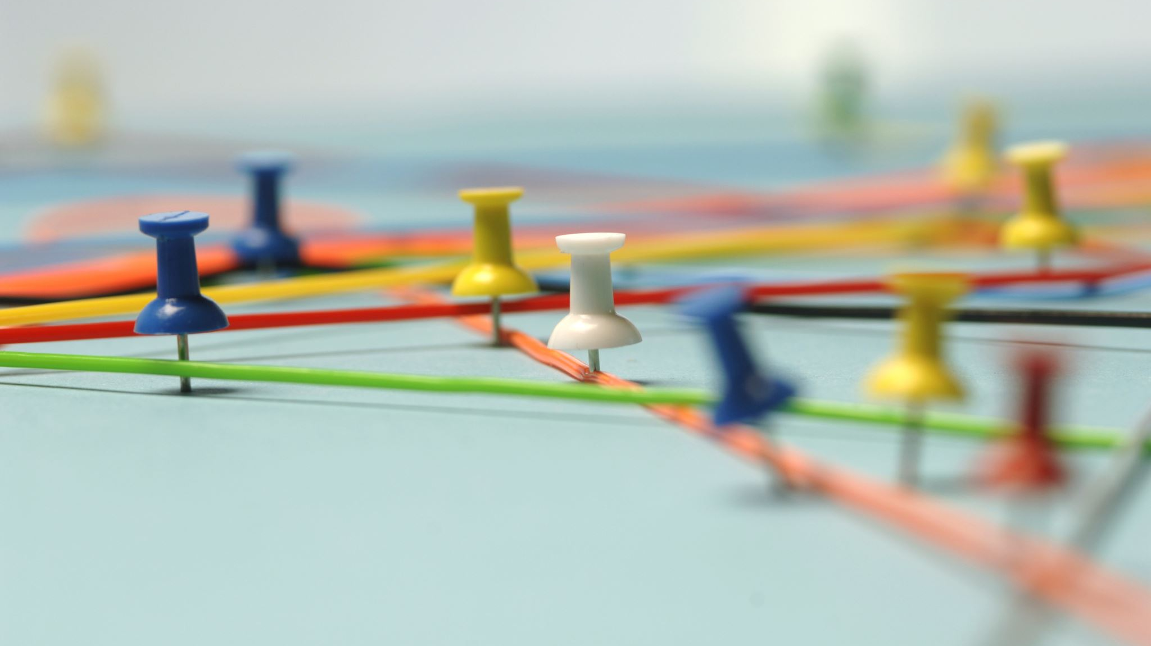
Deploying the Model

Slide 21
Step 3: Deploy the Model
Download the TFlite model
Download new tflite model and move to working folder
Run the python script
‘python Chu-Object-Detection-Fall-2021.py’ in Terminal

Slide 22
References
https://www.tensorflow.org/
https://sci2s.ugr.es/weapons-detection
https://github.com/tensorflow/examples
https://www.digikey.com/en/maker/projects/how-to-perform-object-detection-with-tensorflow-lite-on-raspberry-pi/b929e1519c7c43d5b2c6f89984883588
https://colab.research.google.com/github/khanhlvg/tflite_raspberry_pi/blob/main/object_detection/Train_custom_model_tutorial.ipynb
https://dasci.es/transferencia/open-data/24705/
https://github.com/tzutalin/labelImg
https://sci2s.ugr.es/sites/default/files/files/TematicWebSites/WeaponsDetection/BasesDeDatos/WeaponS.zip
https://sci2s.ugr.es/sites/default/files/files/TematicWebSites/WeaponsDetection/BasesDeDatos/WeaponS_bbox.zip
https://storage.googleapis.com/download.tensorflow.org/data/android_figurine.zip

